Slide 1
Business
as unusual
ETL with PySpark
Radmila Velickovic, Junior Data Engineer @P3
Data Science Conference 2022, Belgrade, Serbia

Slide 2
AGENDA
Before we start
Let's get to know each other quickly
Why PySpark?
Workshop flow
-The Setup
-Let's code
-Wrapping-up in the context of the (automotive) industry
5 . Useful resources
6. Let's stay in touch
STRATEGIC
ADVISORY
STRATEGIC ADVISORY
MANAGEMENT
CONSULTING
DIGITAL
SOLUTIONS
MANAGEMENT CONSULTING

Slide 3
AGENDA
Before we start
Let's get to know each other quickly
Why PySpark?
Workshop flow
-The Setup
-Let's code
-Wrapping-up in the context of the (automotive) industry
5 . Useful resources
6. Let's stay in touch
STRATEGIC
ADVISORY
STRATEGIC ADVISORY
MANAGEMENT
CONSULTING
DIGITAL
SOLUTIONS
MANAGEMENT CONSULTING

Slide 4
Before we start
Topics to be covered:
Hands-on data manipulation with PySpark
ETL Process
Data Warehousing
Materials are to be found here: https://github.com/Radmila-R-lady/ds2022
and here: google drive DS2022
This is an introductory Workshop. No previous knowledge is assumed or required.

Slide 5
AGENDA
Before we start
Let's get to know each other quickly
Why PySpark?
Workshop flow
-The Setup
-Let's code
-Wrapping-up in the context of the (automotive) industry
5 . Useful resources
6. Let's stay in touch
STRATEGIC
ADVISORY
STRATEGIC ADVISORY
MANAGEMENT
CONSULTING
DIGITAL
SOLUTIONS
MANAGEMENT CONSULTING

Slide 6
Let's get to know each other quickly
Radmila Velickovic
MA Survey Methodology and Public Opinion, University of Neuchatel, Switzerland
Exchange Programme in Data Science, UZH, Switzerland
My Stack:
R, Python, PySpark
Power BI
Azure Databricks, Azure DevOps, Azure Data Factory
Fields of Interests:
Data Engineering, Big Data, Data analysis and Visualization,
Automotive industry, IT Recruiting and HR Analytics,
German Language
Business as unusual

Slide 7
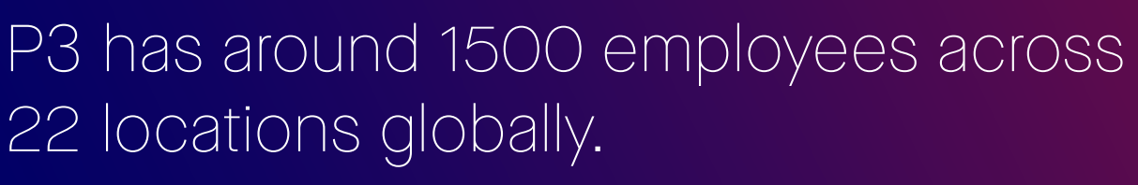
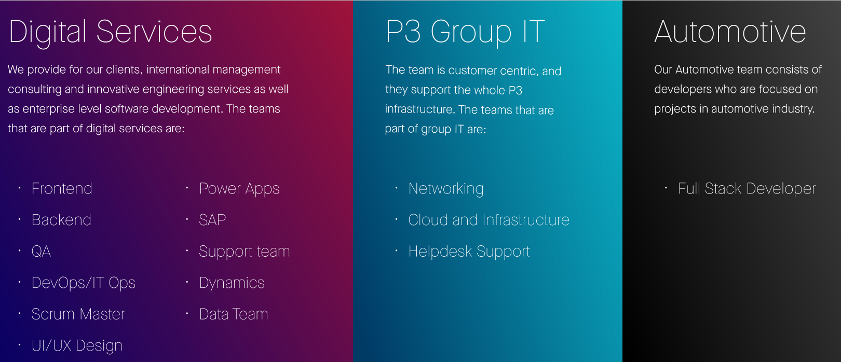
Let's get to know each other quickly

Slide 8
Let's get to know each other quickly
I would like to get to know. Feel free to contact me after this session or we can meet at Crowne Plaza.

Slide 9
AGENDA
Before we start
Let's get to know each other quickly
Why PySpark?
Workshop flow
-The Setup
-Let's code
-Wrapping-up in the context of the (automotive) industry
5 . Useful resources
6. Let's stay in touch
STRATEGIC
ADVISORY
STRATEGIC ADVISORY
MANAGEMENT
CONSULTING
DIGITAL
SOLUTIONS
MANAGEMENT CONSULTING

Slide 10

Why PySpark?
What is actually PySpark?
Programming language
computational engine that works with huge sets of data by processing them in parallel and batch systems.
PySpark is the Python API for Apache Spark

Slide 11
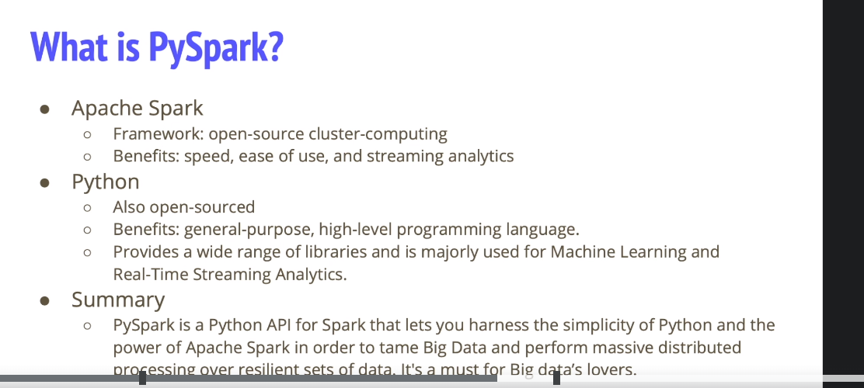
Why PySpark?
By Leyla AI

Slide 12
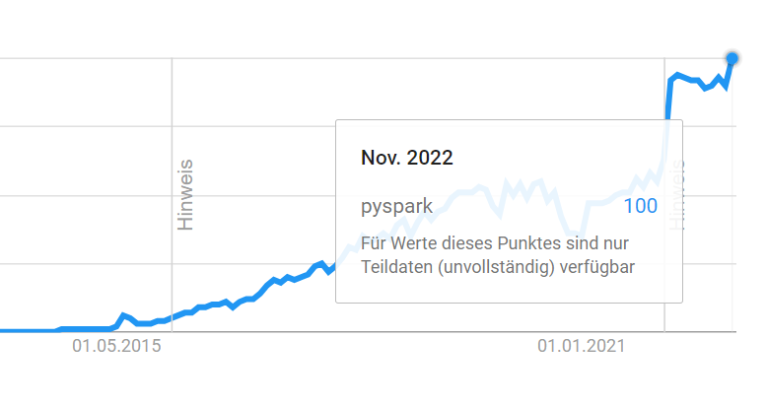
Why PySpark?
With in-memory processing, it helps increase the speed of processing
the parallelization of work over multiple cores and even multiple nodes (servers) by distributed computing, allowing to scale up computational performance by allocating more hardware.
It much better than other languages when it comes to real-time stream processing.
Python is far better in the available libraries.
Notes:
Google trends for the keyword PySpark

Slide 13
AGENDA
Before we start
Let's get to know each other quickly
Why PySpark?
Workshop flow
-The Setup
-Let's code
-Wrapping-up in the context of the (automotive) industry
5 . Useful resources
6. Let's stay in touch
STRATEGIC
ADVISORY
STRATEGIC ADVISORY
MANAGEMENT
CONSULTING
DIGITAL
SOLUTIONS
MANAGEMENT CONSULTING

Slide 14
Workshop flow
Setting things up
Some of IDEs you can use:
Jupyter Notebook: https://jupyter.org/try-jupyter/lab/
PyCharm: https://www.jetbrains.com/help/pycharm/configuring-third-party-tools.html#web-browsers
Google Colab: https://colab.research.google.com/#scrollTo=GJBs_flRovLc
Azure Databrick: https://accounts.azuredatabricks.net/workspace-select
Use case:
You are about to buy a car, and you want to understand the market better in terms of what is being offered. At the initial point you consider both new and used cars.
You are sure about the following preferences:
The car make must be a german (the list of car manufacturers can be found on Wikipedia; our focus is on the big ones)
The year of production is 2015 and above
You take care of the environment, and you want the car to have as small CO2 Emission as possible (measured in g/km)

Slide 15
Workshop flow
Setting things up
Data
We will be using 2 datasets:
AutoScout24de from Kaggle
UsedCars: https://carfueldata.vehicle-certification-agency.gov.uk/search-new-or-used-cars.aspx

Slide 16
Workshop flow
Let's code
The code for today's session can be found on:
https://github.com/Radmila-R-lady/ds2022

Slide 17
Workshop flow
Wrapping - up
In the real world: various data sources, different databases
PySpark has number of advantages
But differs from Python
Great interest for learning PySpark and well-documented issues on Stackoverflow
Error produced by PySpark are sometimes not clear
Great resources to use
ETL vs ELT

Slide 18
Workshop flow
Wrapping - up
Understanding the story behind data
Why we collect certain data and what can we do with it?
Example of CO2
Worldwide Harmonised Light Vehicle Test Procedure (WLTP)
laboratory test used to measure fuel consumption and CO2 emissions from passenger cars

Slide 19
AGENDA
Before we start
Let's get to know each other quickly
Why PySpark?
Workshop flow
-The Setup
-Let's code
-Wrapping-up in the context of the (automotive) industry
5 . Useful resources
6. Let's stay in touch
STRATEGIC
ADVISORY
STRATEGIC ADVISORY
MANAGEMENT
CONSULTING
DIGITAL
SOLUTIONS
MANAGEMENT CONSULTING

Slide 20
Useful resources
PySpark Documentation: https://spark.apache.org/docs/latest/api/python/
https://stackoverflow.com/questions/58138669/how-to-change-the-name-of-spark-application-after-it-is-started
https://stackoverflow.com/questions/69251699/specify-column-datatype-in-pyspark
Lit function: https://sparkbyexamples.com/pyspark/pyspark-lit-add-literal-constant/#:~:text=PySpark%20lit()%20%E2%80%93%20Add%20Literal%20or%20Constant%20to%20DataFrame&text=PySpark%20SQL%20functions%20lit(),Column%20type%20as%20return%20type.
isin function: https://sparkbyexamples.com/spark/spark-isin-is-not-in-operator-example/
Explode function: https://sparkbyexamples.com/pyspark/pyspark-isin-and-in-operator/#:~:text=PySpark%20isin()%20or%20IN,evaluated%20values%20of%20the%20arguments.
Leyla AI resources

Slide 21
AGENDA
Before we start
Let's get to know each other quickly
Why PySpark?
Workshop flow
-The Setup
-Let's code
-Wrapping-up in the context of the (automotive) industry
5 . Useful resources
6. Let's stay in touch
STRATEGIC
ADVISORY
STRATEGIC ADVISORY
MANAGEMENT
CONSULTING
DIGITAL
SOLUTIONS
MANAGEMENT CONSULTING

Slide 22

6. Let's stay in touch
https://www.linkedin.com/in/radmila-velichkovich/
https://github.com/Radmila-R-lady
Or see you @CrownePlaza
https://www.p3-group.com/en/

Slide 23
Enjoy the conference
and have fun

